Slide 2
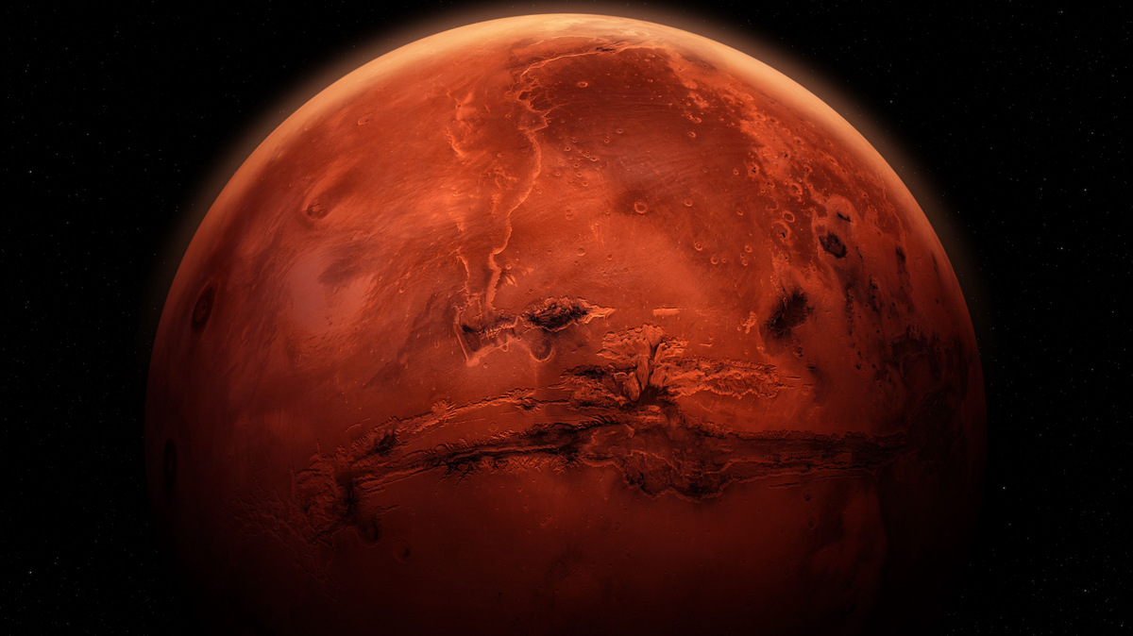
Zoli
Szabi
Mars Exploration Random Map Generator
Dani
A Project developed by:
Imi

Slide 3
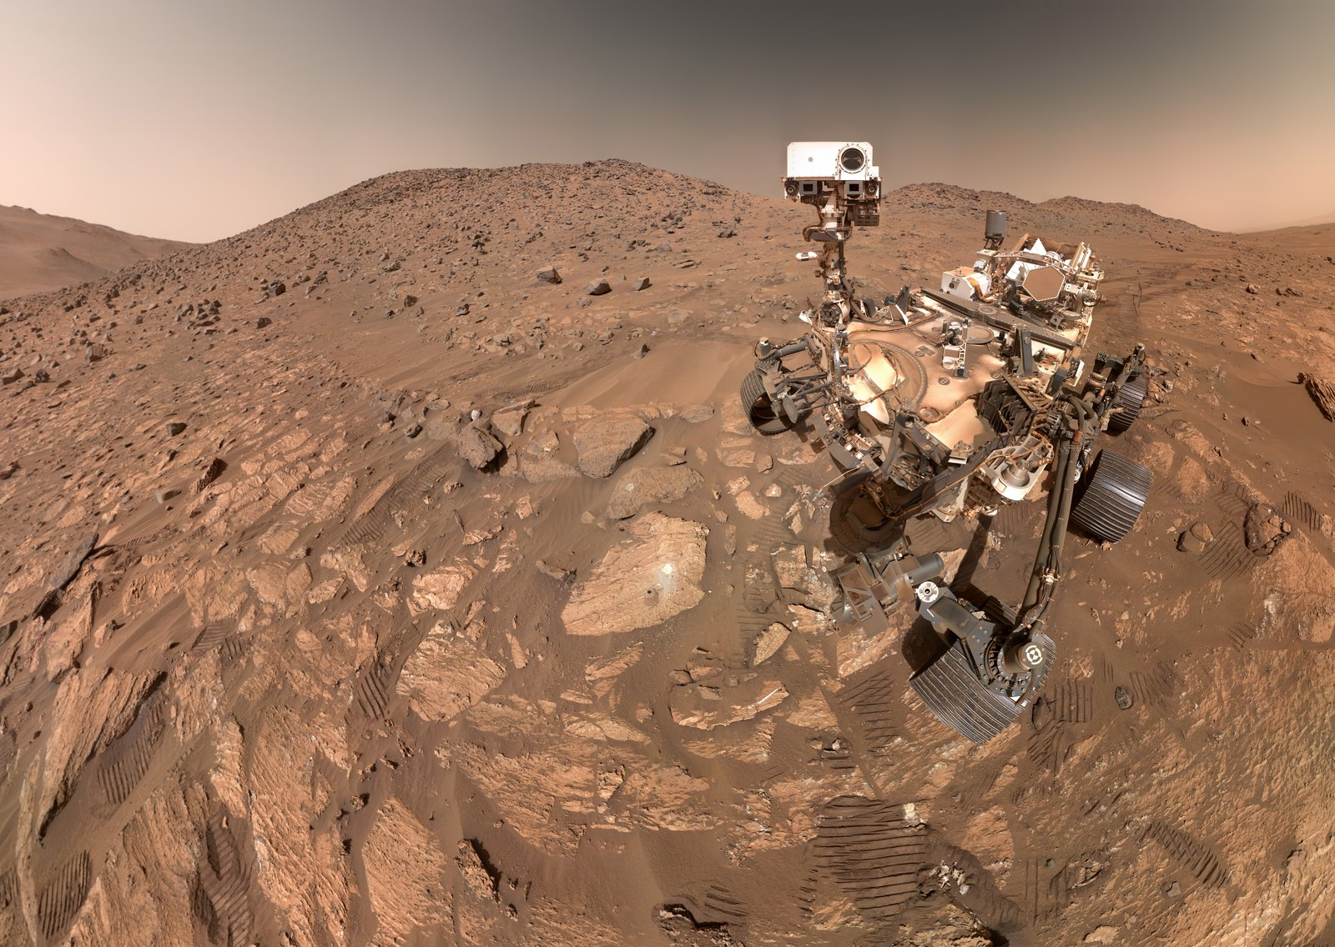
Our goal
Simulate Mars terrain by generating randomized maps.
Why?
Test rover navigation software in realistic, changing terrain.
Main Features:
- Create square maps with configurable size. -
- Place terrain elements and resources. -
- Configurable and repeatable map generation. -

Slide 4
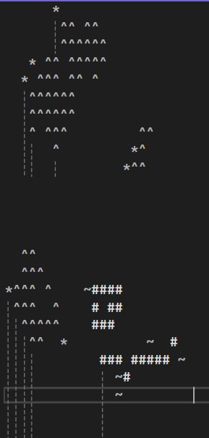
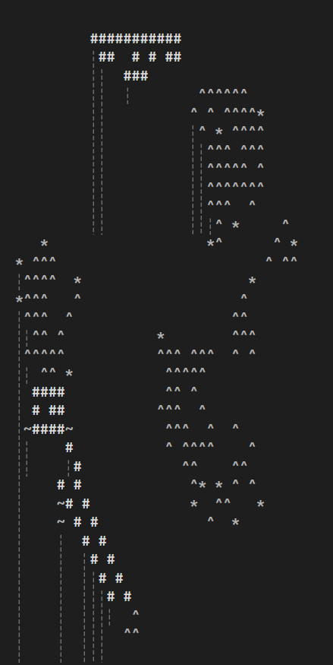
Terrain Elements:
Mountains (^) – large areas
Pits (#) – large areas
Resources:
Minerals (*) – near mountains
Water pockets (~) – near pits
(Keep in mind these symbols can be changed freely)

Slide 5
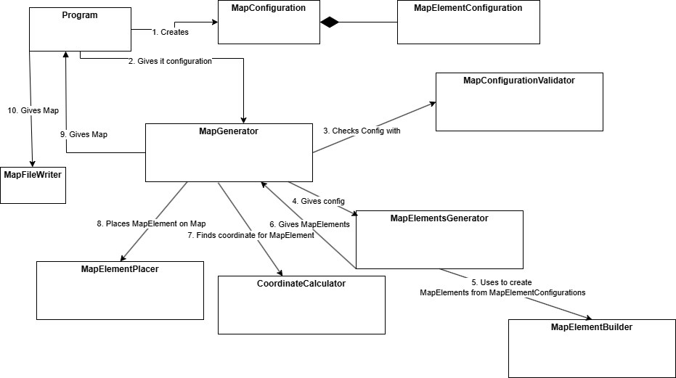
The Program creates a MapConfiguration with terrain and resource settings.
The MapGenerator validates it using MapConfigurationValidator.
It sends this config to the MapGenerator.
Finally, MapFileWriter saves the finished map to a file.
It passes config to the MapElementsGenerator.
MapElementPlacer places them on the map.
Once elements are created, CoordinateCalculator finds valid positions for them.
Which uses MapElementBuilder to create terrain and resource elements.

Slide 6
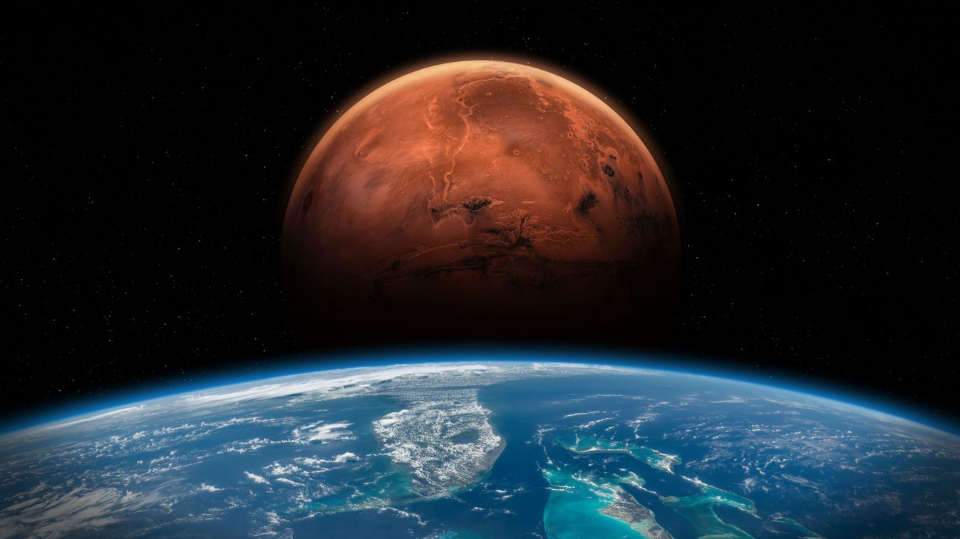
Thank you for your attention!
Please feel free to ask any questions!
If you don’t have any questions start generating your own Mars!

